Slide 1
FingerBand
Team4

Slide 2
Outline
Pattern
System Architecture
Class Diagram
Line of code
Demo

Slide 3
Pattern
Reactor
Connector
Acceptor
Chain of responsibility
Factory method
Singleton
Builder
Iterator
Object Pool

Slide 4
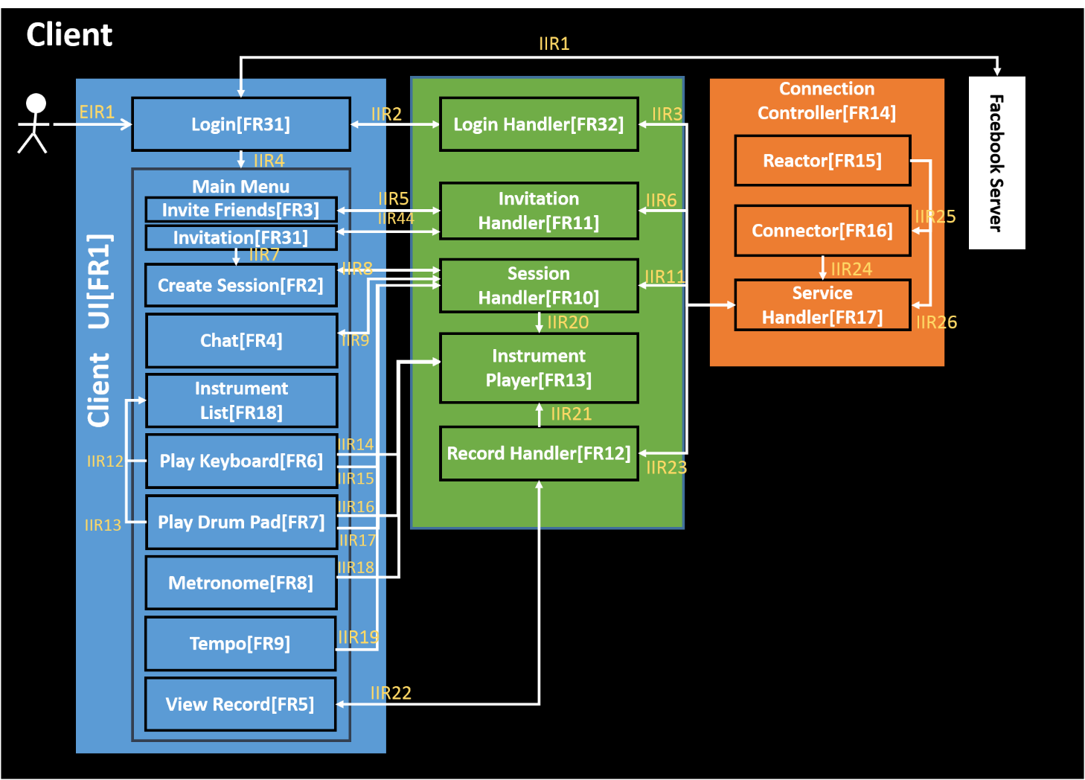
Reactor,Connector
Chain of Responsibility

Slide 5
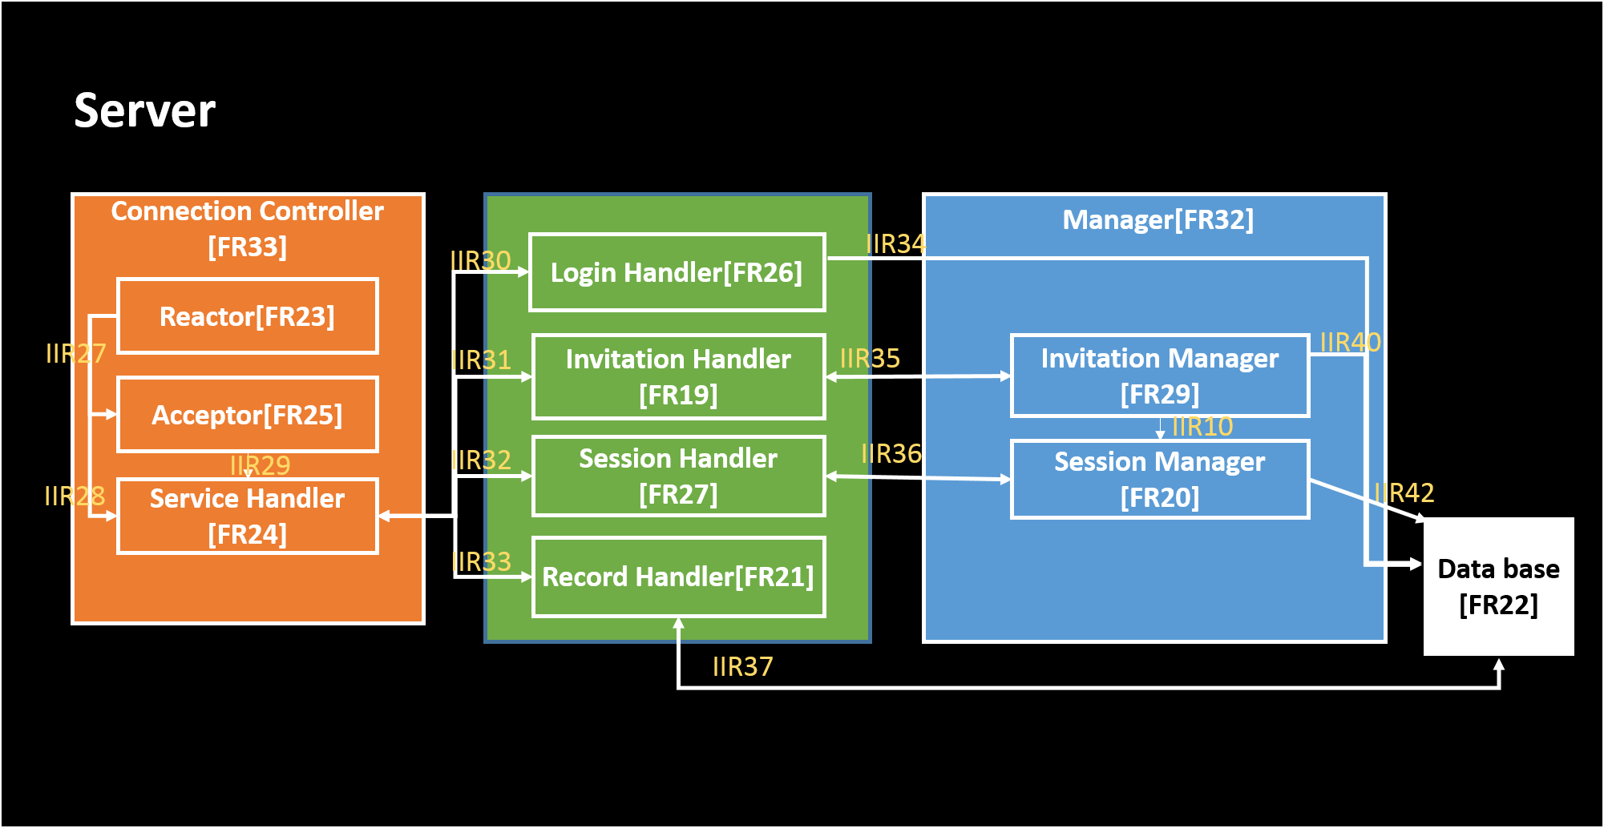
Reactor, Acceptor
Chain of Responsibility

Slide 6
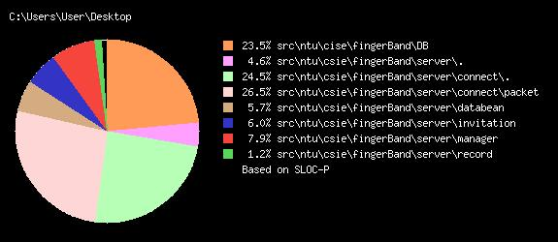
Line of code-Server
2553

Slide 7
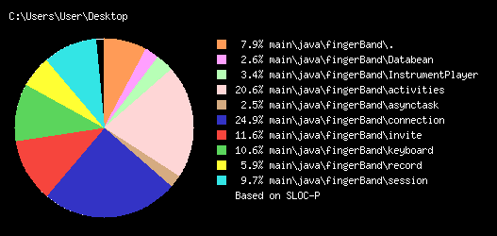
Line of code-client
3010

